Slide 1


Developing system for private tutor matching
SE Dept.
students: Sami oDEh
Or Eliyahu
SUPERVISORS: Mrs. Elena Kramer Dr. dan lemberg

Slide 2


Introduction
The main purpose of Matching tutor system is to enhance the tutoring experience, in-person and online.
Mutual feedback for a better match between students and tutors.

Slide 3

What's Happening today
The private tutor plays a key role in the student experience.
Today students look for private tutors according to previous recommendation.
Finding a suitable tutor still takes time and resources for students.
Finding a tutor based only on his knowledge is not enough today.

Slide 4

Motivation
Finding the most suitable private tutor for a student.
We plan on saving resources and effort for the students by filtering tutors and reducing the number of unsuccessful meetings.

Slide 5


Quadratic Programming
Is the process of solving a special type of mathematical optimization problem.
Given a real-valued, n-dimensional vector $\vec{c}$, a $n x n$ real matrix $Q$, an $m x n$ dimensional real matrix $A,$ and an m-dimensional real vector $\vec{b}$.
The objective of quadratic programming is to find an n-dimensional vector $\vec{x}$, that will minimize $\frac{1}{2}x^{T}Qx+c^{T}x$ while subject to $Ax≤b$.
Background

Slide 6

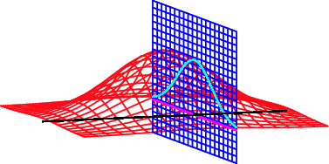

Lagrange Multipliers
Minimize $f\left(x_{1},x_{2}..., x_{n}\right)$
Constraint $g\left(x_{1},x_{2}..., x_{n}\right)=0$
We need to solve this equation $∇f=−λ∇g$ in order to minimize $f$
$\frac{∂f}{∂x_{k}}+λ\frac{∂g}{∂x_{k}}=0, | for all k=1,…,n$
Constant $λ$ is called the Lagrange multiplier
Background

Slide 7

Quadratic Programming
We will then define a Lagrange function $L\left(x, μ\right)=\frac{1}{2}x^{T}Qx+c^{T}x+μ^{T}(Ax−b)$, and find a solution using KKT conditions as done for other nonlinear problems:
$∇L\left(x,μ\right)= c^{T}+\frac{1}{2}x^{T}Q+ μ^{T}A=0$
$μ^{T}\left(Ax−b\right)=0$
$x^{T}, μ^{T}≥0$
For positive definite Q, the ellipsoid method solves the problem in polynomial time. If, on the other hand, Q is indefinite, then the problem is NP-hard.
Background

Slide 8

Our approach
Defining a new question vector for a student
Student answer the questionnaire
Calculate the matching grade
Getting a feedback from the private tutor
Updating the tutor weights vector using QP
Updating the student answers vector using QP
Our approach

Slide 9
Our approach
Defining a new question vector for a private tutor
Private tutor answer the questionnaire
Calculate the matching grade *
Getting a feedback from the student
Updating the student weights vector using QP
Updating the tutor answers vector using QP
Our approach

Slide 10


QP example
Student answers vector: [0.6, 0.7]
Tutor weights vector : [75, 25]
Student matching grade is $0.6⋅75+0.7⋅25=62.5$
Student set a meeting with the Tutor
After the meeting tutor fills a bad feedback about the student, a change in tutor weight vector is required.
Minimize $f(x_{1},x_{2}) ={(x_{1}−75)}^{2} +$ ${(x_{2}−25)}^{2}$
Constraints $g(x_{1},x_{2}) = 0.6⋅x_{1} + 0.7⋅x_{2} ≤ 60$
New weights vector is : [73.23, 22.94]
New matching grade is : $0.6⋅73.23+0.7⋅22.94=59.99$
Our approach

Slide 11

QP example
Minimize $f(x_{1},x_{2}) ={(x_{1}−75)}^{2} +$ ${(x_{2}−25)}^{2}$
Constraints $g(x_{1},x_{2}) = 0.6⋅x_{1} + 0.7⋅x_{2} ≤ 60$
$g\left(x_{1},x_{2}\right)= 0.6⋅x_{1} + 0.7⋅x_{2} −60=0$
$∇f(x_{1},x_{2})$ = $2⋅\left(x_{1}−75\right)\hat{x_{1}}+2⋅\left(x_{2}−25\right)\hat{x_{2}}$
$∇g(x_{1},x_{2})$ = $0.6\hat{x_{1}}+0.7\hat{x_{2}}$
$∇f+λ∇g=$ $2⋅\left(x_{1}−75\right)\hat{x_{1}}+2⋅\left(x_{2}−25\right)\hat{x_{2}}+λ\left(0.6\hat{x_{1}}+0.7\hat{x_{2}}\right)=0$
$x_{1}=\frac{1245}{17}=73.23, x_{2}=\frac{390}{17}=22.94, λ=\frac{100}{17}=5.88$
Our approach

Slide 12


Defining a new question vector
Let say a student has $n_{1}$ questions and private tutor has $n_{2}$ questions.
Administrator defines the student and private tutor questionnaire.
The weights of those questions represented by a vector $\overset{⃑}{m_{i}}=({m_{1}}_{1},{m_{1}}_{2}, …, {m_{1}}_{n_{i}})$.
The answers of $\overset{⃑}{m_{i}}$ represented by a new vector $\overset{⃑}{t_{i}}=\left({t_{1}}_{1},{t_{1}}_{2}, …, {t_{1}}_{n_{i}}\right), {t_{1}}_{j}∈\left[0, 1\right]$.
The weights $\overset{⃑}{m_{i}}$ vector of the questions will be initialized by the same weight of each question $\frac{100}{n_{i}}$ or by amount of weights that sum to 100.
Our approach

Slide 13

answer the questionnaire
On registration, the student and the tutor must answer the questions about themselves.
This step is similar to the process of giving feedback after the end of the session.
Our approach

Slide 14


Calculate the matching grade
According to weight vector and the user answer vector, the matching grade can be calculated as $\vec{m}⋅\vec{t}=\sum_{i=1}^{n}{m_{i}∗t_{i}}$.
Our approach

Slide 15


Find the most suitable tutors pseudocode
$$\text{1.} \text{Input}\text{:} \text{student} \text{as} \text{S}\text{, }\text{tutors} \text{as} \text{T}\text{, }\text{course} \text{as} \text{C}\text{, }\text{minimal} \text{matching} \text{grade} \text{as} \text{P}$$
$$\text{ 2. }\text{Output}\text{: }\text{most} \text{suitable} \text{tutors} \text{list} {\text{S}}_{\text{T}}$$
$$\text{ 3.} {\text{L}}_{\text{T}}\text{←}\text{T}\text{.}\text{get}\text{_}\text{tutors}\left(\text{course}\text{=}\text{C}\right)$$
$\text{ 4.} {\text{S}}_{\text{T}}\text{←[]}$
$$\text{ 5.} \text{for} \text{t}\text{∈}{\text{L}}_{\text{T}} \text{do}$$
$\text{ 6.} \text{p}\text{ = }\text{t}\text{.}\overset{⃑}{{\text{m}}_{\text{2}}}\text{ ⋅ }{\text{S}\text{.}\overset{⃑}{{\text{t}}_{\text{2}}}}^{\text{T}}$
$\text{ 7.} \text{if} \text{p}\text{ > }\text{P} \text{then}$
$\text{ 8.} {\text{S}}_{\text{T}}\text{.}\text{insert}\text{(}\text{t}\text{, }\text{p}\text{)}$
$\text{ 9.} {\text{S}}_{\text{T}}\text{.}\text{sort}\left(\text{by} \text{p}\right)$
$\text{10.} \text{return} {\text{S}}_{\text{T}}$
Our approach

Slide 16

Getting a feedback
After a meeting, both sides need to fill feedback on each other.
Our approach

Slide 17


Updating the weight vector using QP
Let $\overset{⃑}{x}=(x_{1}, x_{2},…, x_{n})$ be the new weights vector, then $f\left(\vec{x},\vec{m}\right)$ needs to be minimized, where $f\left(\vec{x},\vec{m}\right)={\left(x_{1}−m_{1}\right)}^{2}+{\left(x_{2}−m_{2}\right)}^{2} + ... + {\left(x_{n}−m_{n}\right)}^{2}$.
Quadratic programming equation needs to take the form of $\frac{1}{2}x^{T}Qx+c^{T}x$ while subject to $Ax≤b$, for each $x_{i}≥0, 1≤i≤n$ and $\sum_{i=1}^{n}{x_{i}}=100$.
Our approach

Slide 18

Updating the weight vector using QP
$Q=2∗\left(\begin{matrix}1 & ⋯ & 0 \\ ⋮ & ⋱ & ⋮ \\ 0 & ⋯ & 1\end{matrix}\right),$ in this case 1 for every ${(x_{i})}^{2}, 1≤i≤n$and 0 otherwise.
$\overset{⃑}{c}= −2⋅\overset{⃑}{m}$, n-dimensional vector, saving the coefficient for every $x_{i} , 1≤i≤n$.
Let $k$ be the total number of saved data for student or private tutor.
$A_{k+n×n}$ will save in row $i$the coefficients of the vector $\overset{⃑}{x}$ in inequality
${\overset{⃑}{b}}_{k+n×1}$ will save the value that the inequality is less than or equal to.
Note that the process only works for inequality that is less than or equal to, so all the bigger than inequalities will have to be multiplied by minus one.
Our approach

Slide 19

Video

Slide 20
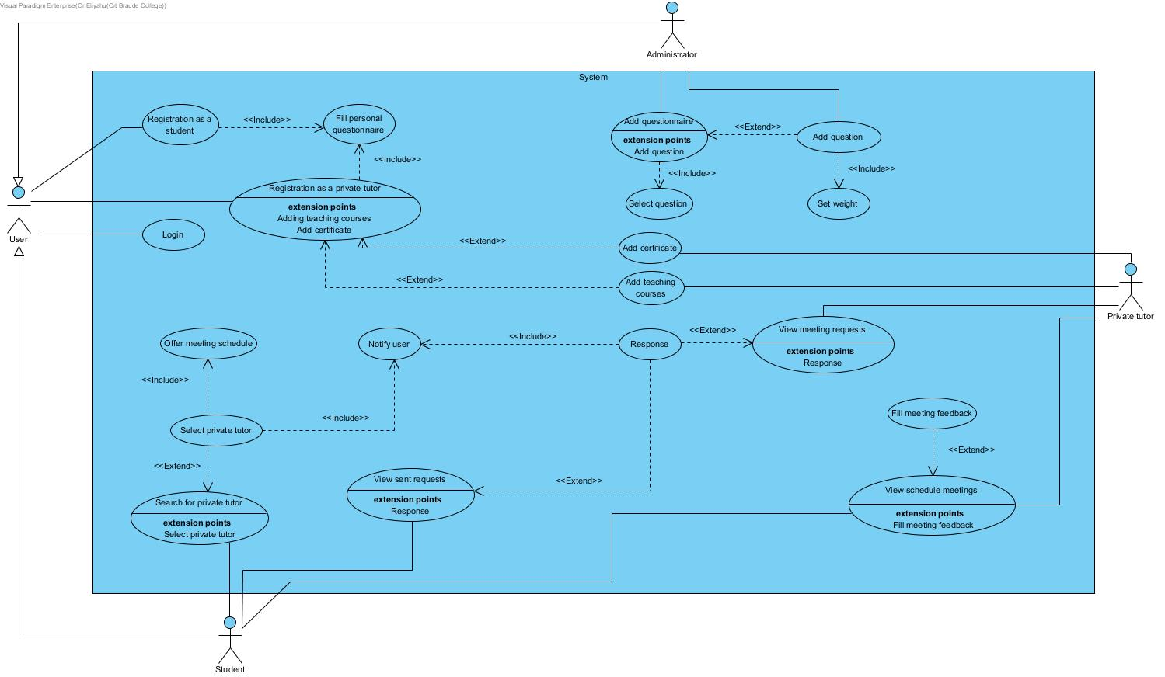
Use Case

Slide 21
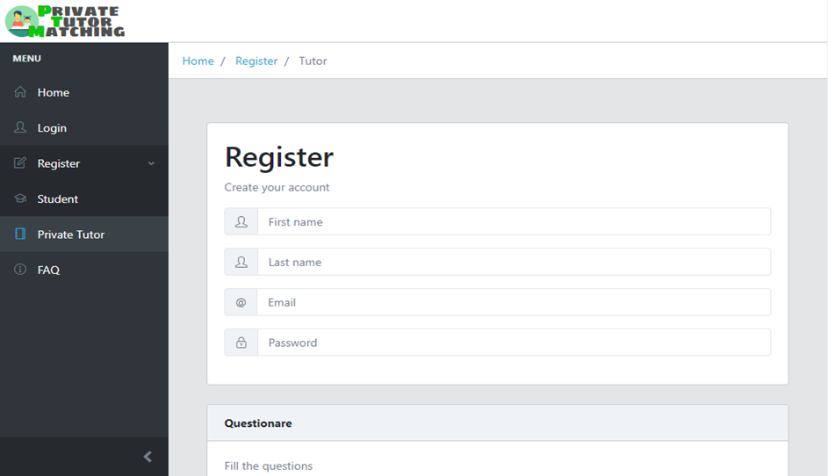
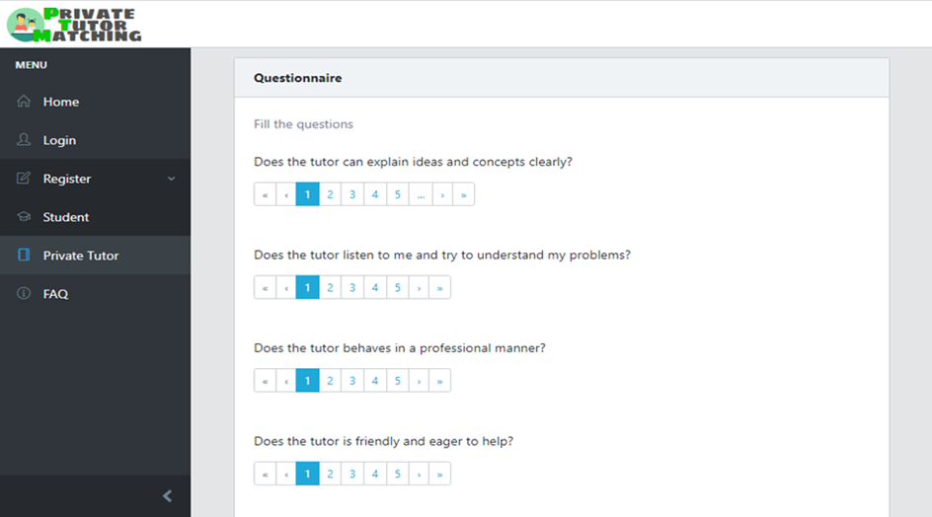
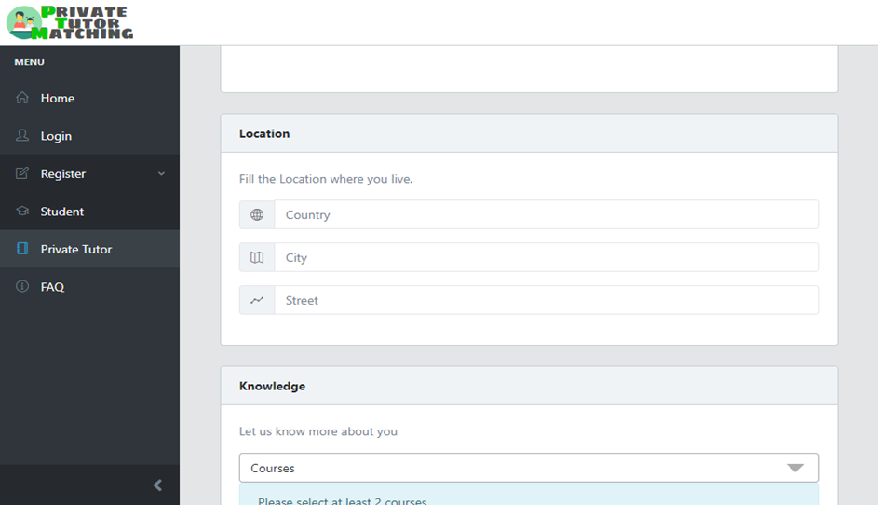
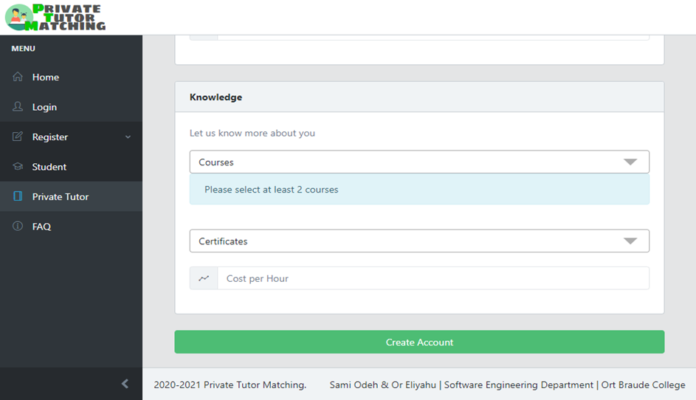
GUI

Slide 22

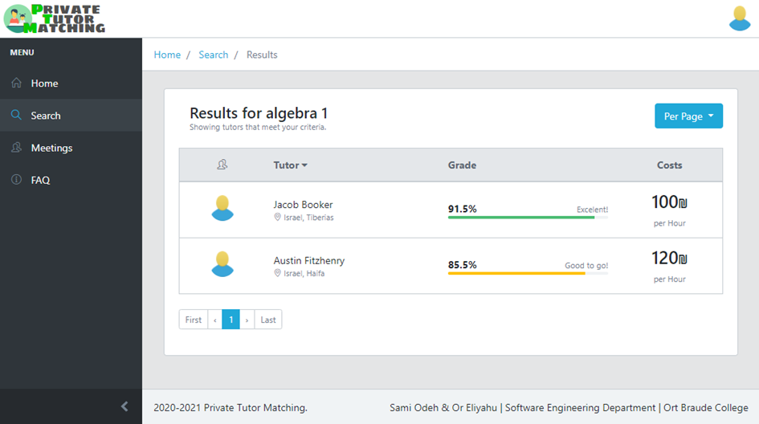
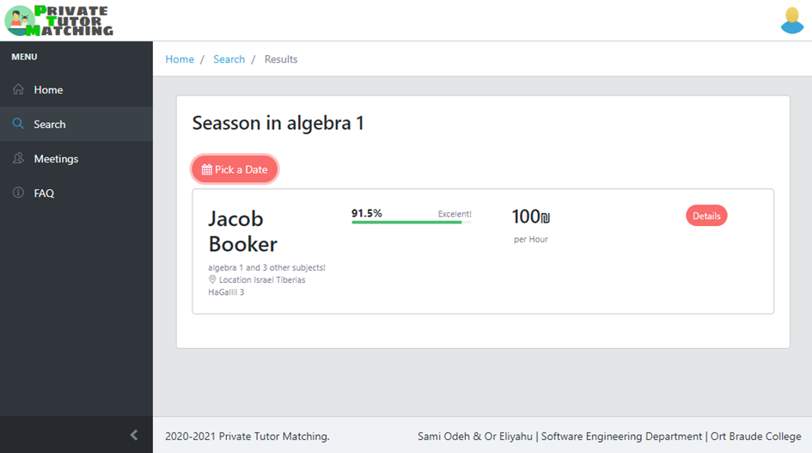
GUI

Slide 23
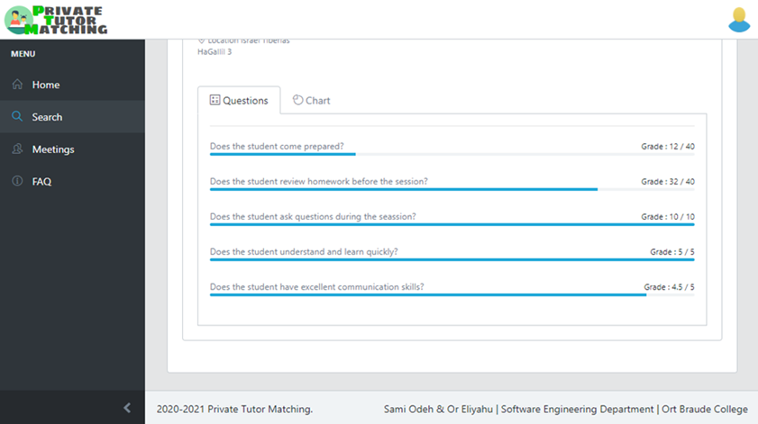
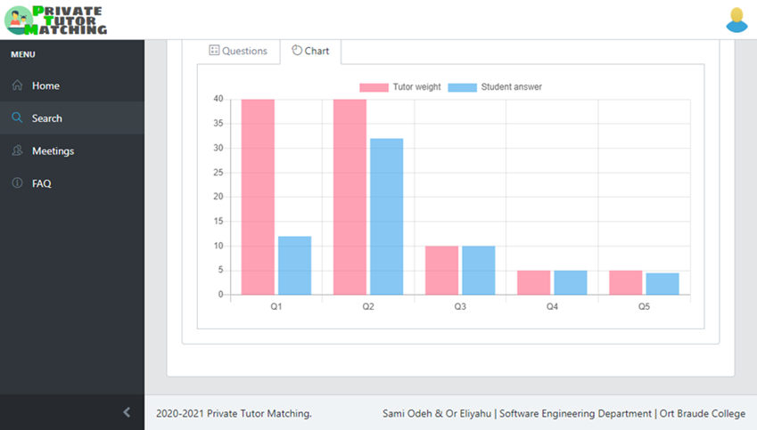
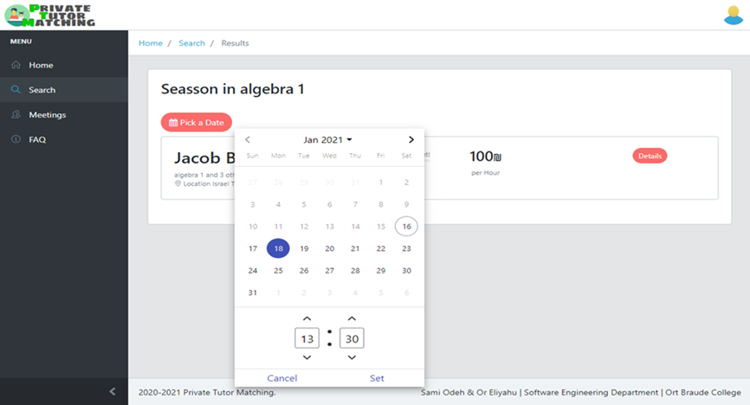
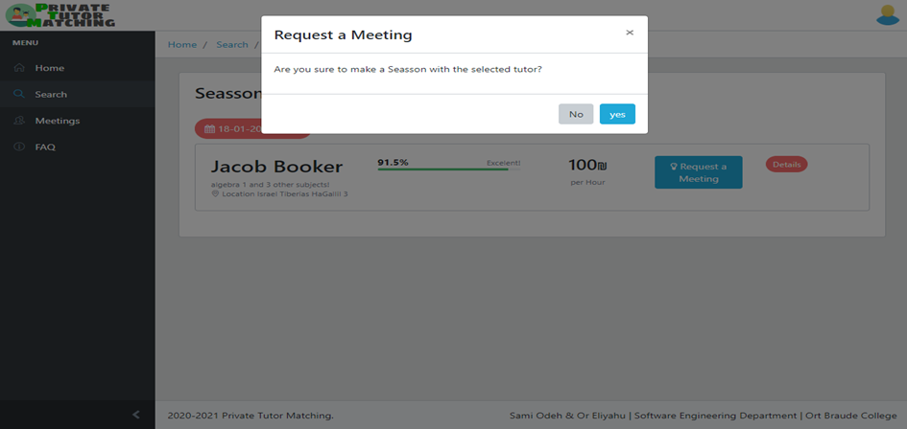
GUI

Slide 24
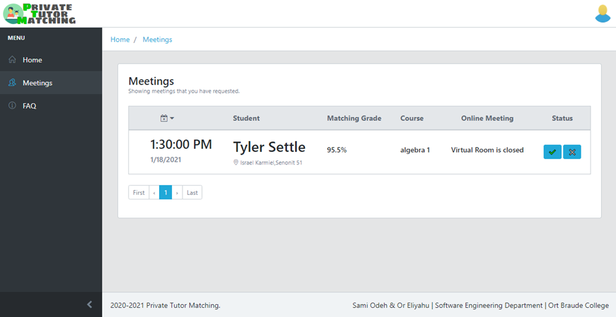
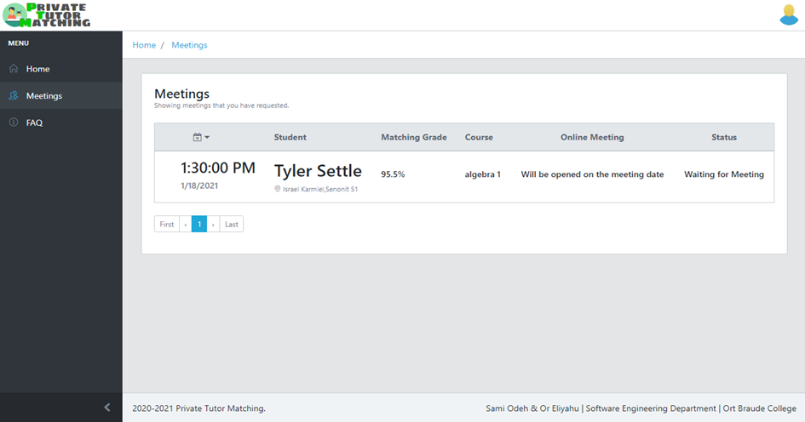
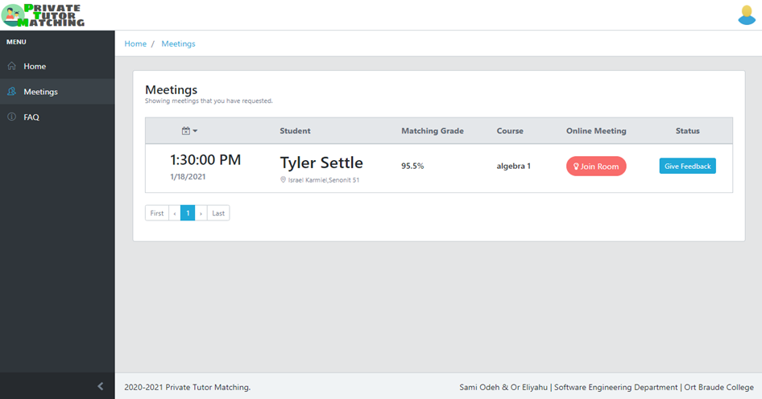
GUI

Slide 25

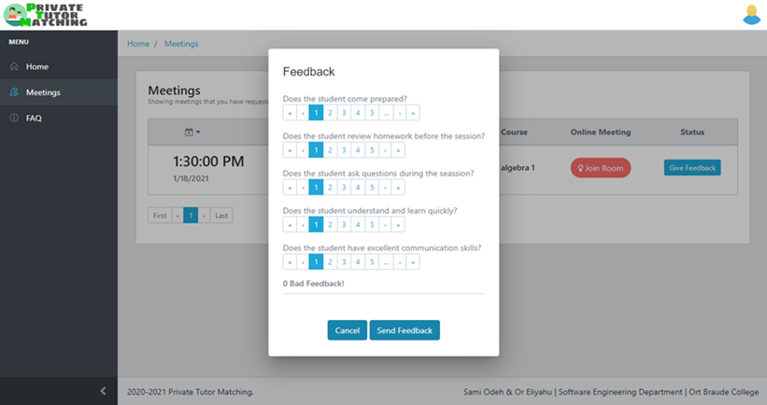
GUI

Slide 26
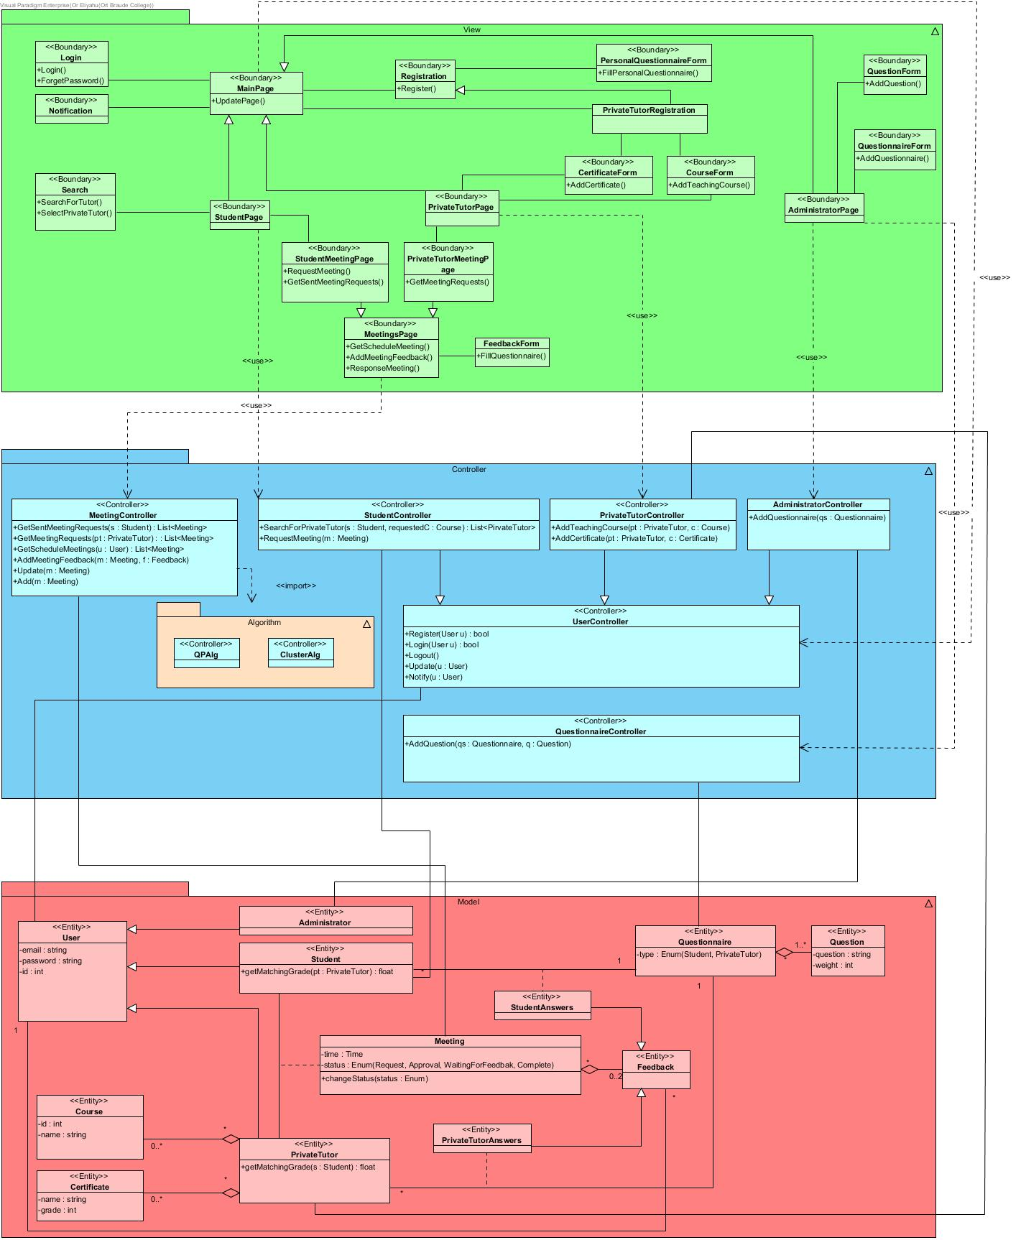
Class Diagram

Slide 27
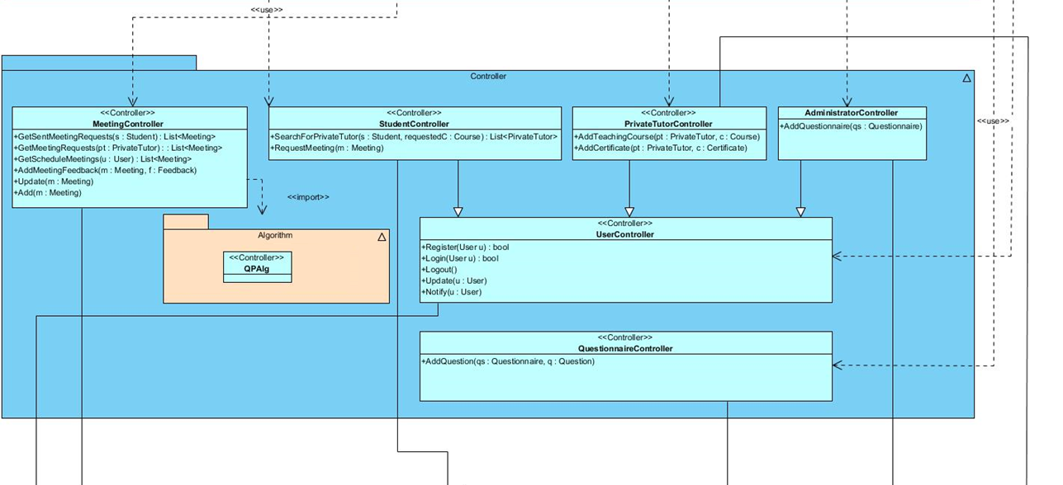
Class Diagram

Slide 28
Class Diagram

Slide 29
Test ID | Description | Expected results | Actual Results
WrongUserName or WrongPassword | Entering invalid username and/or password. | Shows a message: "Wrong Username or Password". | Pass
UpdateWeightsVector | Once user response a feedback, obtain a new weights vector corresponding to the feedback. | Vector v: The best approximation weights vector which meets all the conditions of the weights. | Pass
ScheduleMeeting | According to the test weights, calculating the matching grade, if passed the minimum constant value (P), then he can send meeting request to the private tutor. | Private tutor received a meeting request for the scheduled time. | Pass
SearchSuitablePrivateTutors | After searching for a course, the system offers according to his properties the top suitable private tutors. | The search results page is ordered by the suitable private tutors matching grade. | Pass
Testing Results

Slide 30
Test ID | Description | Expected results | Actual Results
ReceiveMeetingRequest | Once student send a meeting request, the request will be sent to the selected private tutor. | The meeting request has been added to the private tutor meeting page. | Pass
AddTeachingCourse | When the private tutor registers or he want to add more information about himself, he can add teaching courses to increase his options of teaching. | When searching for the newly added course, the system will calculate the matching grade of this private tutor. | Pass
AddCertificate | When the private tutor registers or he want to add more information about himself, he can add certificate to increase his options of teaching. | When searching for some course with the new certificate, the system shows the new certificate for the private tutor. | Pass
Testing Results

Slide 31
Conclusions
Reliability of the users – change in weights and answers vector for better system reliability.
The weights and the answers vector changes according to the feedback and effects the matching grades for all the users.
We have decided to avoid non-results.
Trial period including real users required in order to evaluate the system.
The application can be used for various uses that are not profitable.
Conclusions

Slide 32
Q & A

